Slide 1
Flutter Course 1
2023/08/04

Slide 2
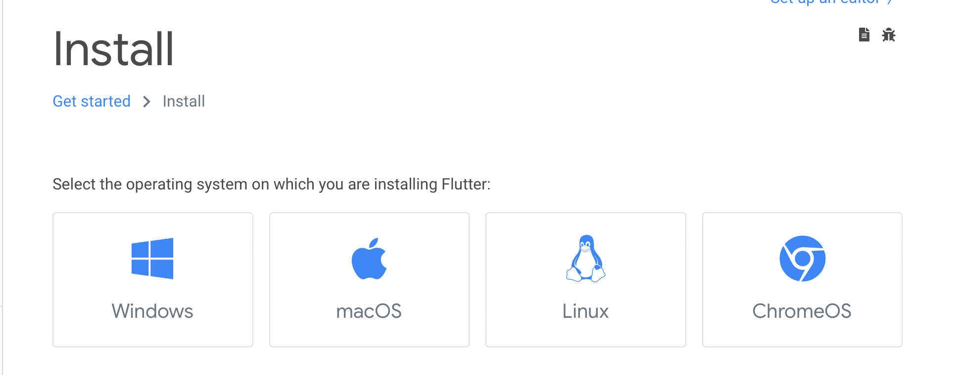
下載Flutter安裝包以及解壓縮
官方下載連結

Slide 3
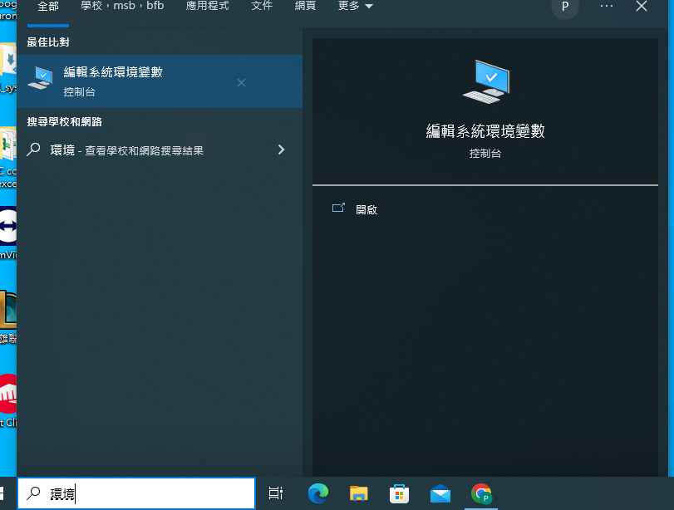
設定環境變數-Windows
搜尋，輸入「環境變數」

Slide 4
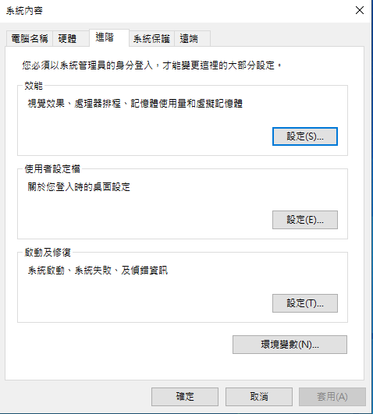
設定環境變數-Windows
新增環境變數

Slide 5
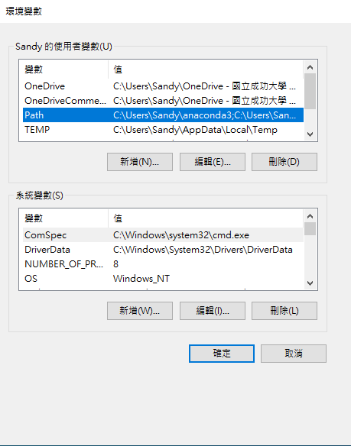
設定環境變數-Windows
點擊Path及編輯

Slide 6
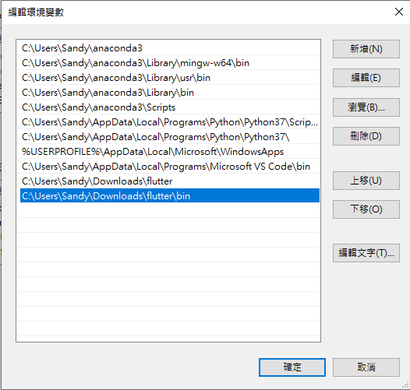
設定環境變數-Windows
點擊新增
並將flutter/bin新增到Path

Slide 7
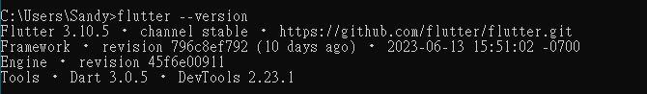
設定環境變數-Windows
叫出命令列，檢查是否新增成功
輸入 flutter --version

Slide 8
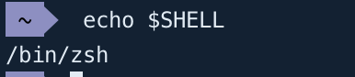
設定環境變數-Mac
叫出終端機
輸入: echo $SHELL (會是 /bin/bash或是 /bin/zsh)
如果是 /bin/bash：編輯 ~/.bash_profile (輸入指令: nano .bash_profile)
新增
export PATH="$PATH:[PATH_OF_FLUTTER_GIT_DIRECTORY]/bin"
儲存離開: ctrl-X > Y > Enter
輸入: source ~/.bash_profile
echo $PATH 會看到剛剛新增的 Flutter 路徑

Slide 9
設定環境變數-Mac
叫出終端機如果是 /bin/zsh ：編輯 ~/.zshrc(輸入指令: open ~/.zshrc)
新增
export PATH="$PATH:/Users/[Username]/[PATH_OF_FLUTTER_GIT_DIRECTORY]/bin”
儲存離開: ctrl-S > 關閉
輸入: source ~/.zshrc
echo $PATH 應該會看到剛剛新增的 Flutter 路徑

Slide 10
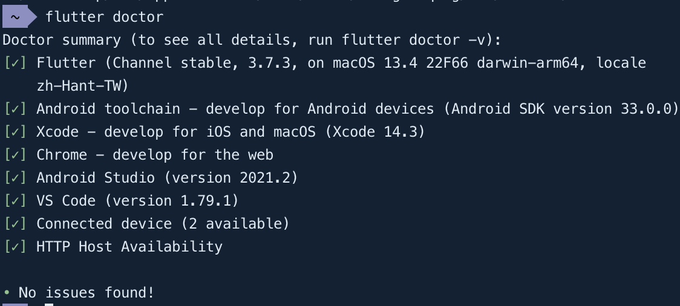
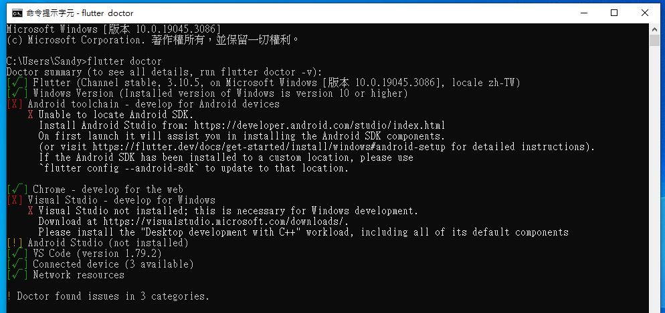
檢查缺什麼套件
叫出命令列/終端機
輸入flutter doctor

Slide 11
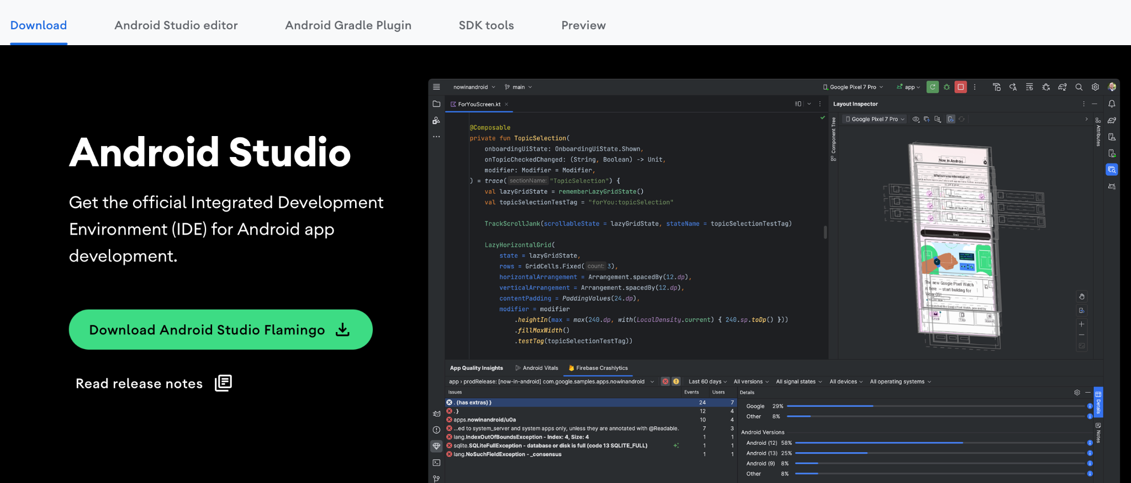
下載Andriod Studio
官方下載連結

Slide 12
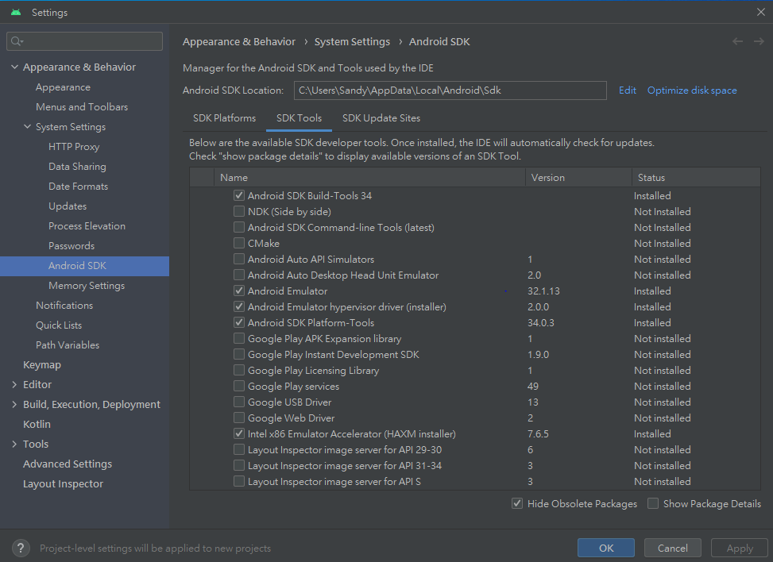
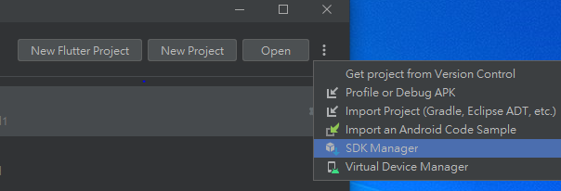
Andriod SDK-Windows
點擊右上角，並選取SDK Manager
點選SDK Tools，跟著圖片打勾
Notes:
windows參考網址：https://www.dotblogs.com.tw/supershowwei/2022/07/18/the-process-that-install-flutter-in-android-studio-on-windows-to-successfully-opening-the-sample-app

Slide 13
Andriod SDK-Mac
在終端機輸入
flutter doctor --android-licenses
Notes:
mac參考網址：https://clay-atlas.com/blog/2021/02/23/flutter-cn-andoird-studio-develop-tutorial/

Slide 14
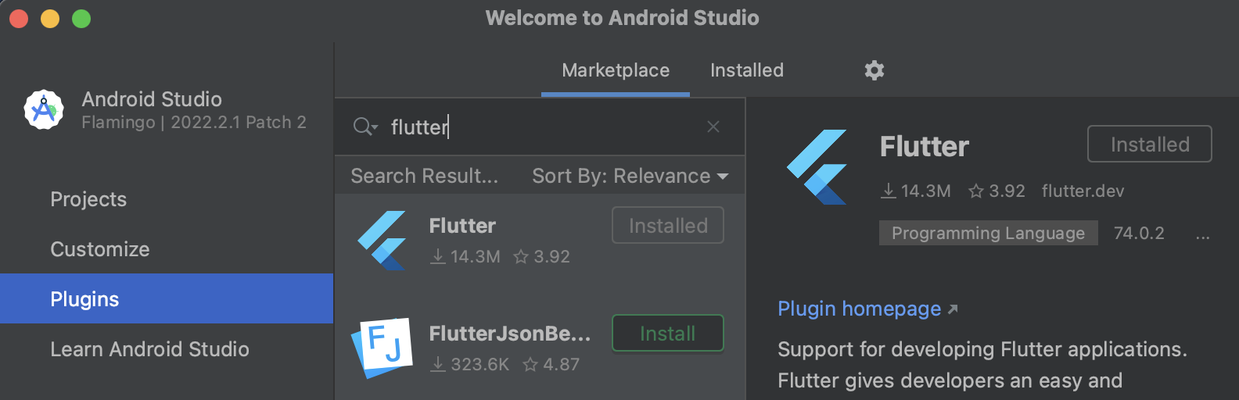
在Andriod Studio下載flutter、dart插件
於Plugins中輸入flutter，點擊第一個並安裝

Slide 15
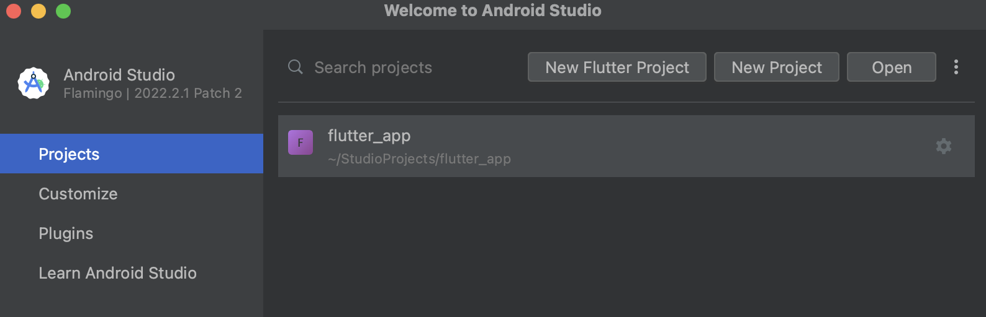
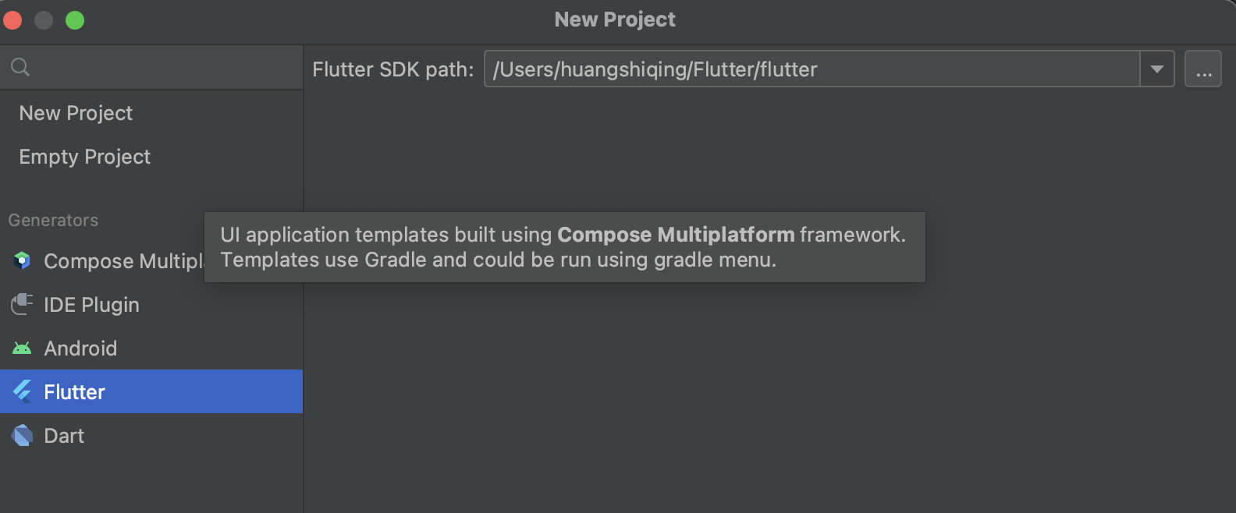
Create a new project
Projects > new flutter project
Flutter > next

Slide 16
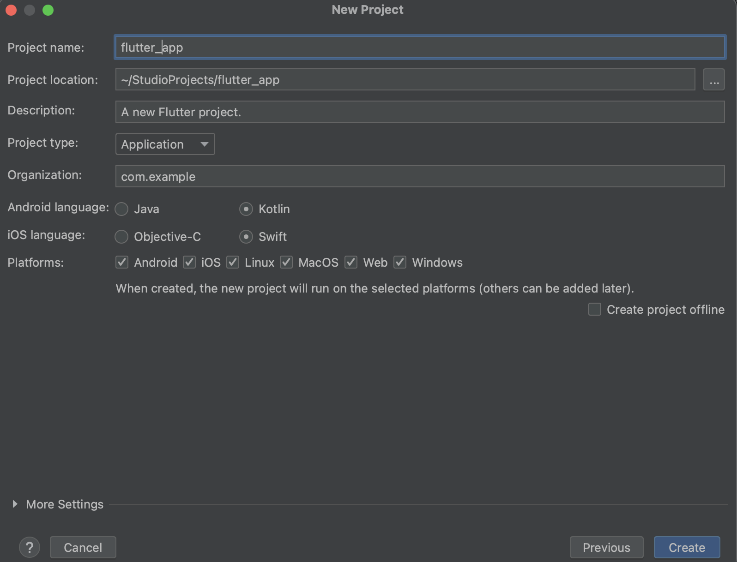
Create a new project
選擇要儲存專案的位置/資料夾
為你的專案取名

Slide 17
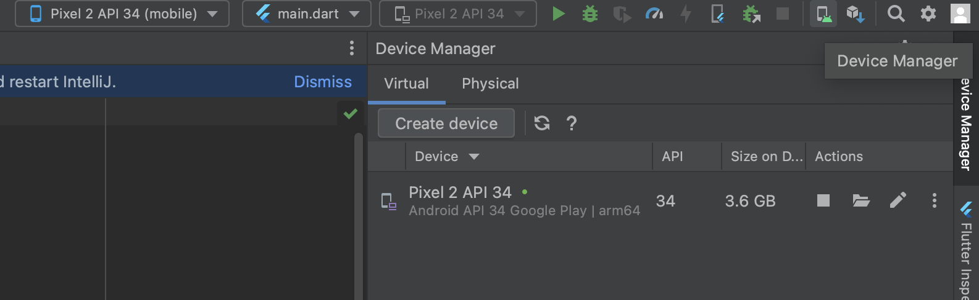
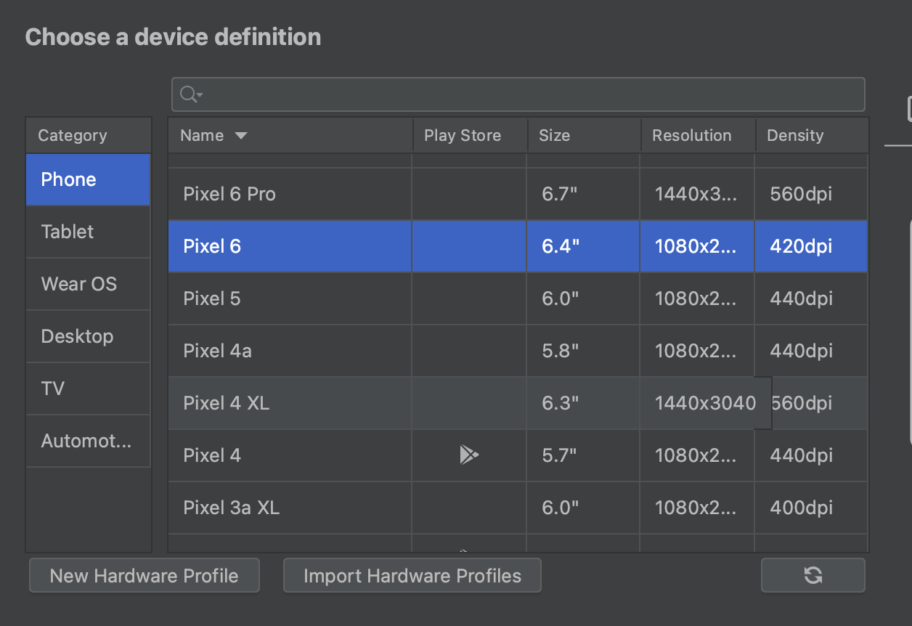
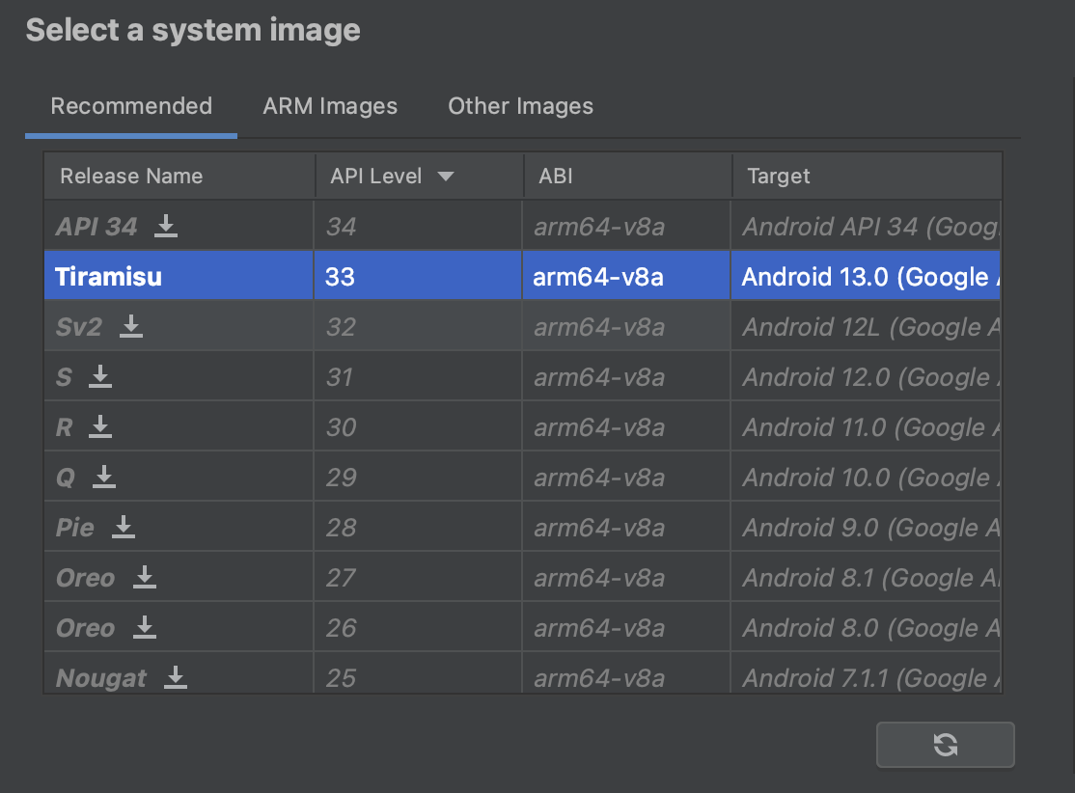
設定模擬器
點擊右上角Device Manager
選擇你要的手機及版本
Notes:
參考：https://ithelp.ithome.com.tw/articles/10189220

Slide 18
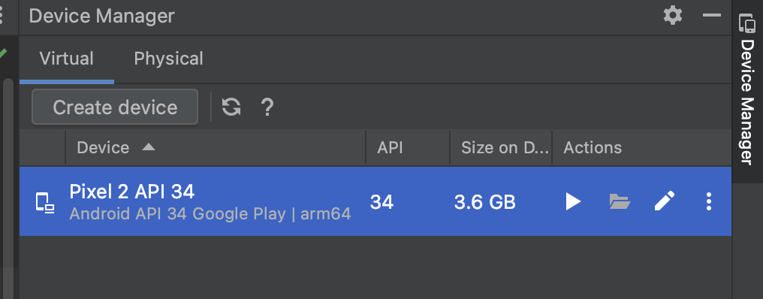
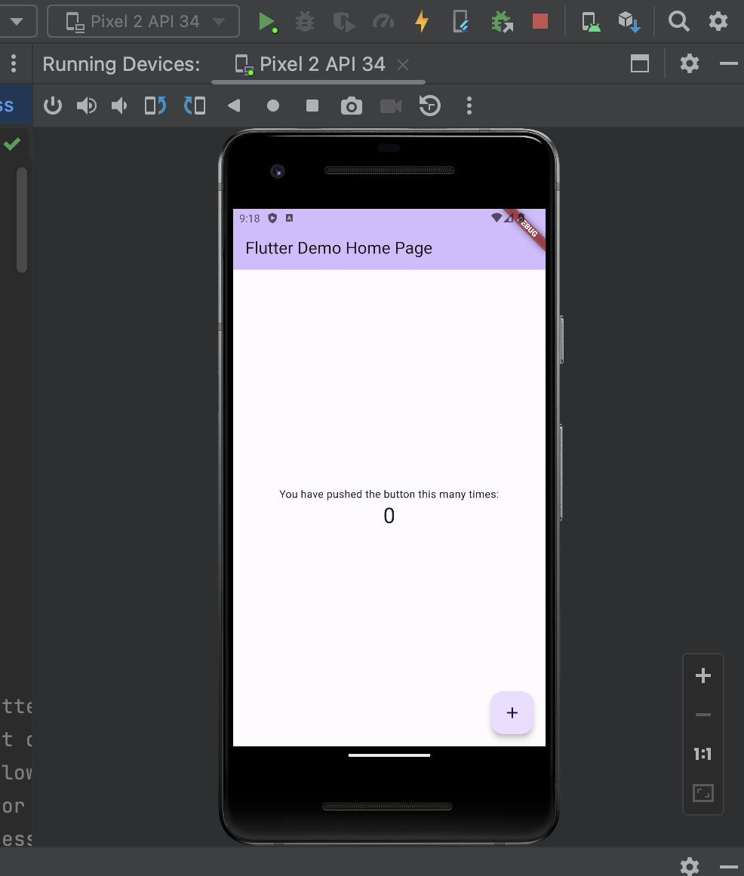
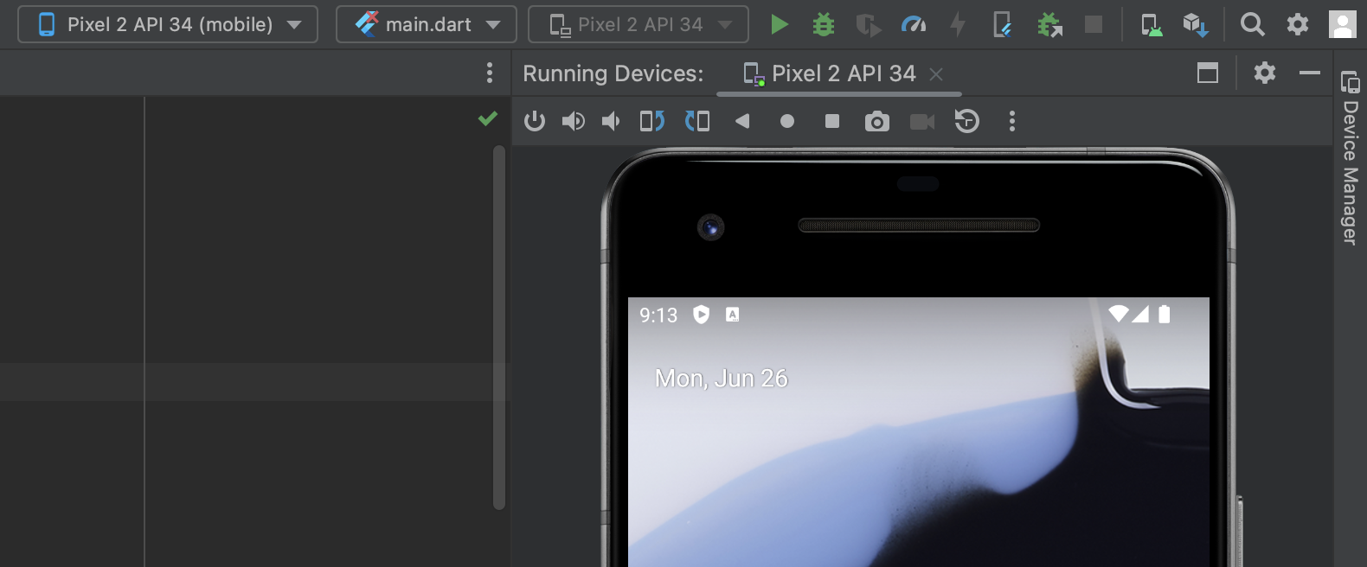
Run your app
點擊Device Manager上的三角形啟動它
右上角可選取你要的模擬器
點擊Run(綠色三角形)將你的專案跑起來

Slide 19
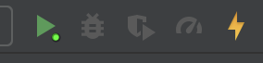
Build mode
Full restart
Recompiles the Java/Kotlin/ObjC/Swift code
Take the longest
Hot reload
Load code change into VM
Preserve app state(doesn’t rerun main() or initState())
Fastest

Slide 20
About Flutter

Slide 21
About Flutter
UI framework developed by Google
Use Dart programming language
Maintain one codebase and deploy to multiple platforms

Slide 22
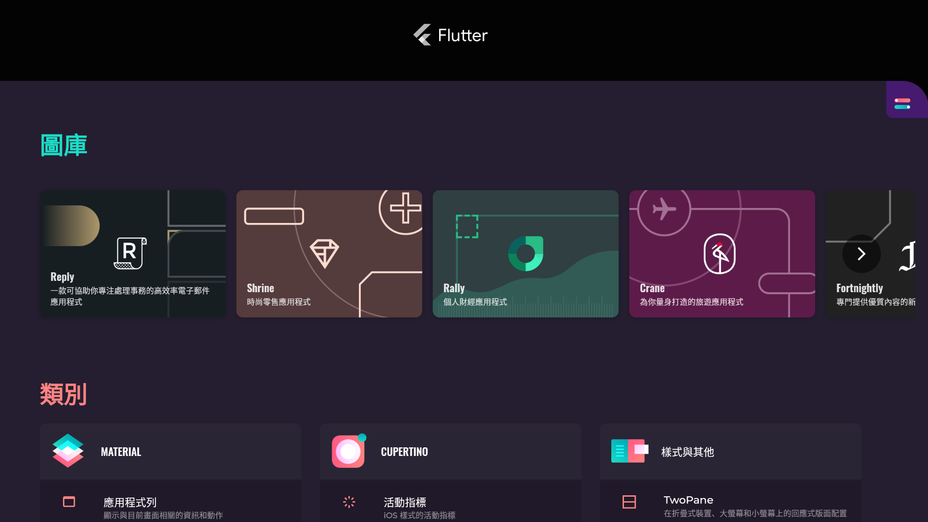
Gallery

Slide 23
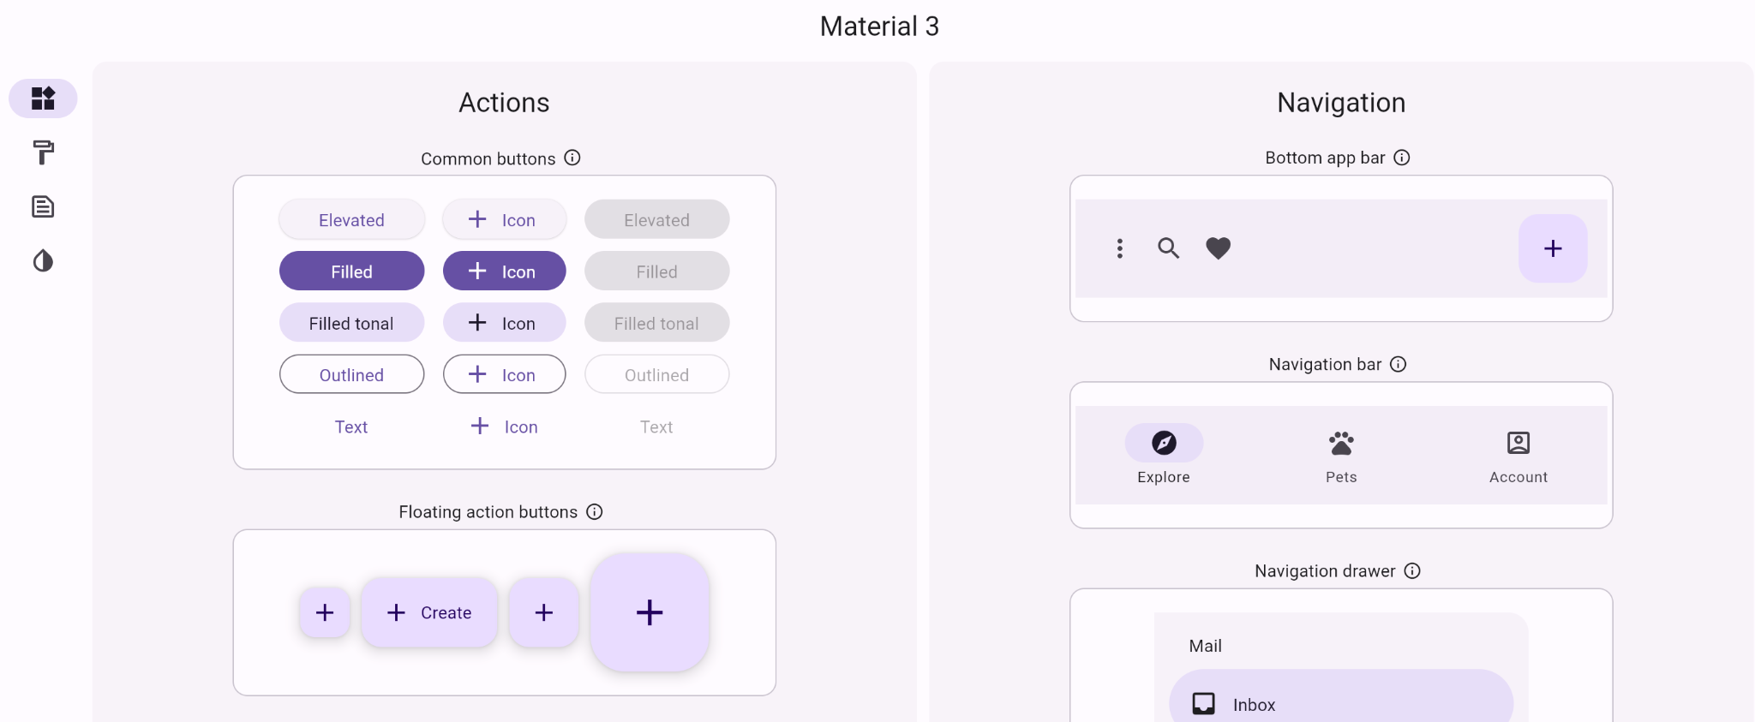
Material 3

Slide 24
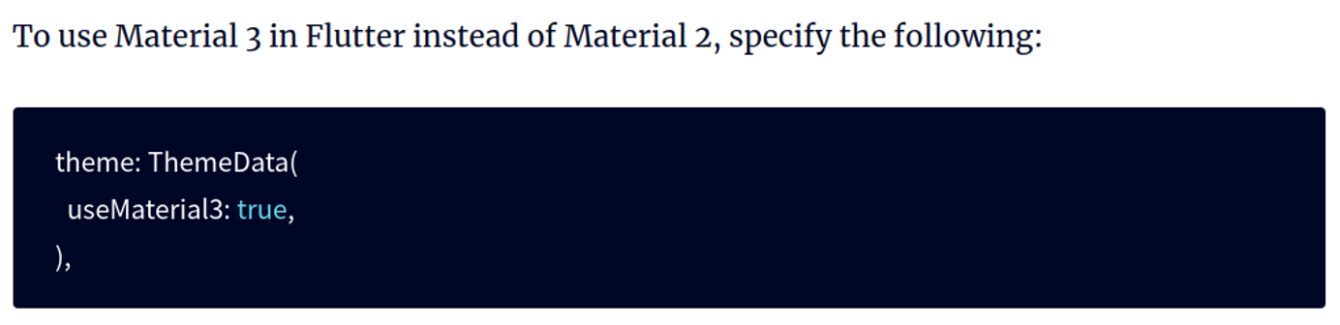
Material 3

Slide 25
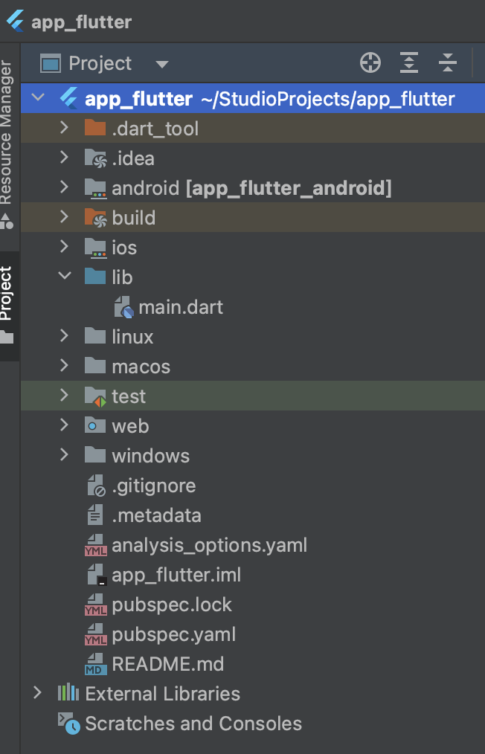
Project Structure - pubspec.yaml
Define your project
Project name
Flutter version used
Package used
Asset used
Add package
Add assets (e.g., image, etc.)
Notes:
When you want to add package or asset (image), edit this file.

Slide 26
Project Structure
lib/
Where you put all your source code.
main.dart
Where everything start.
Main entry point for the program
Notes:
When you want to add package or asset (image), edit this file.

Slide 27
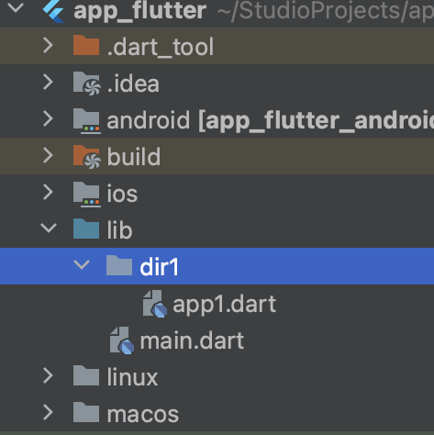
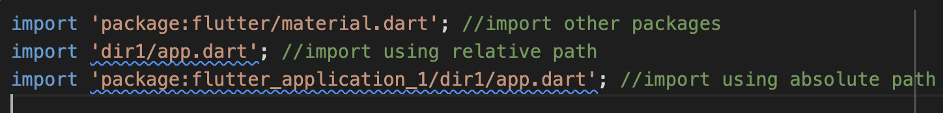
Import packages
Directory structure
main.dart

Slide 28
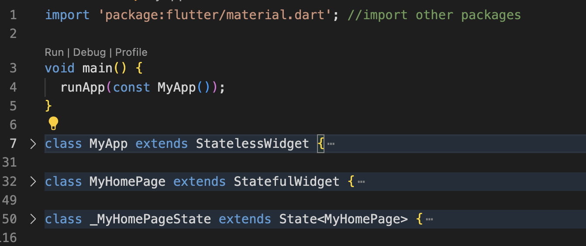
Basic Code Structure
Import
main function
widget 1
widget 2

Slide 29
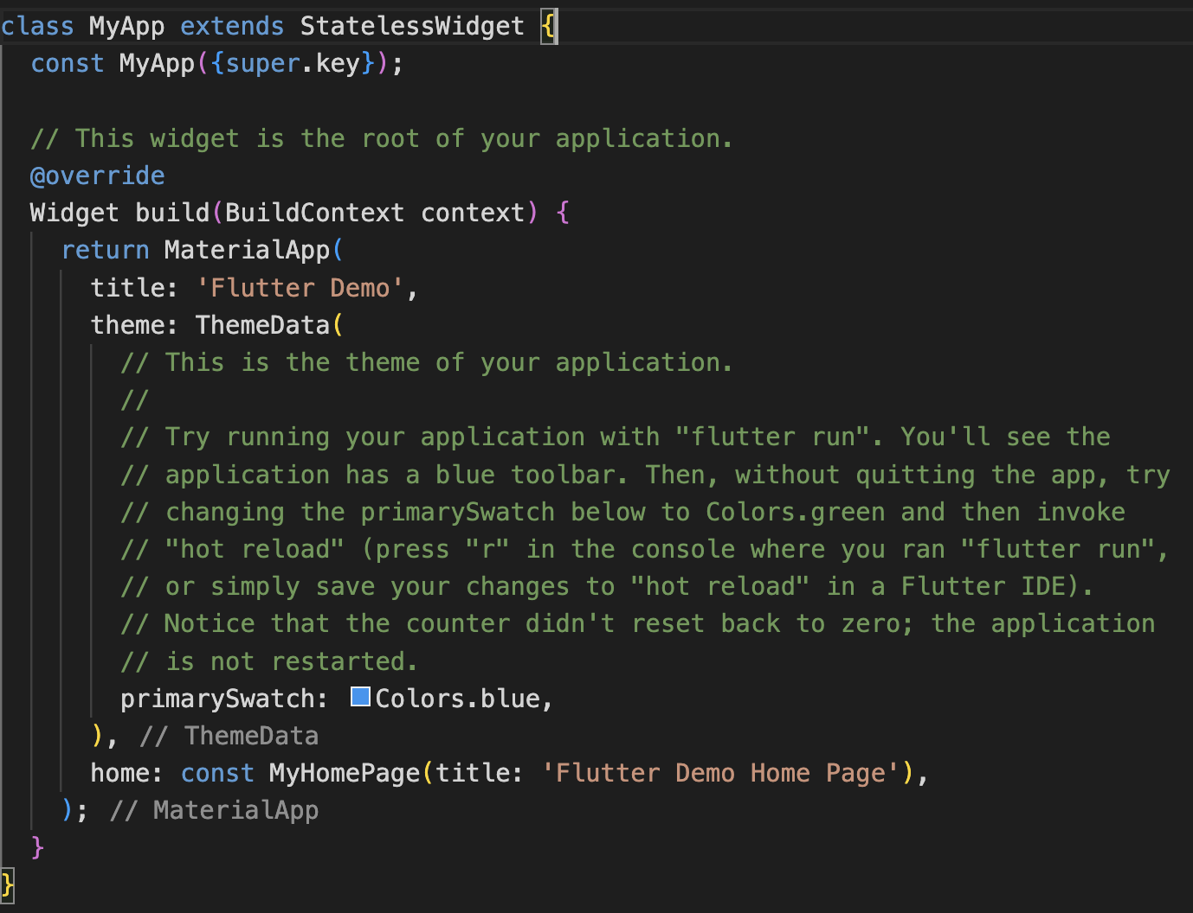
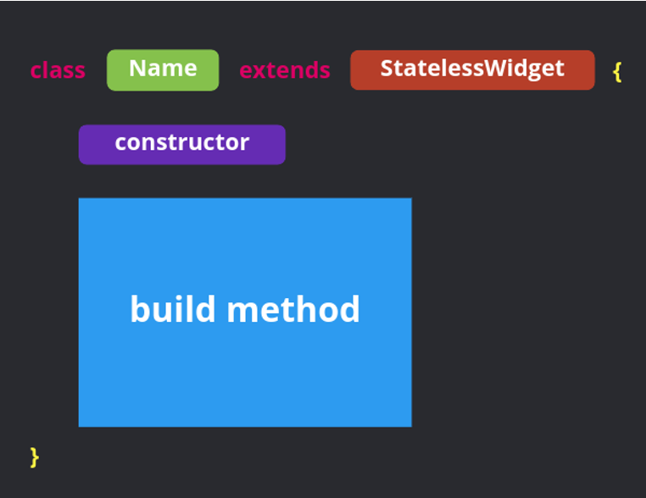
Widget
constructor

Slide 30
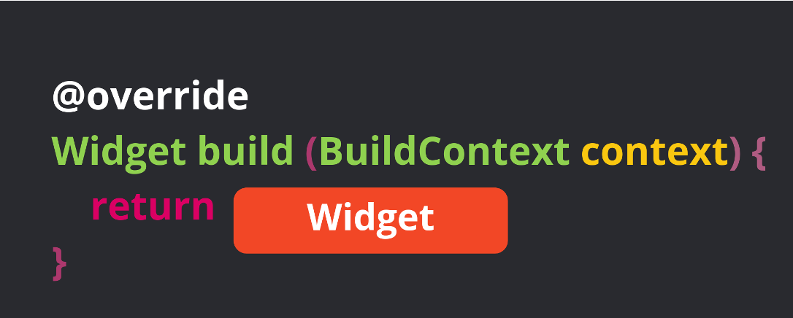
Build Method
Notes:
回上一頁，materialapp是一個widget

Slide 31
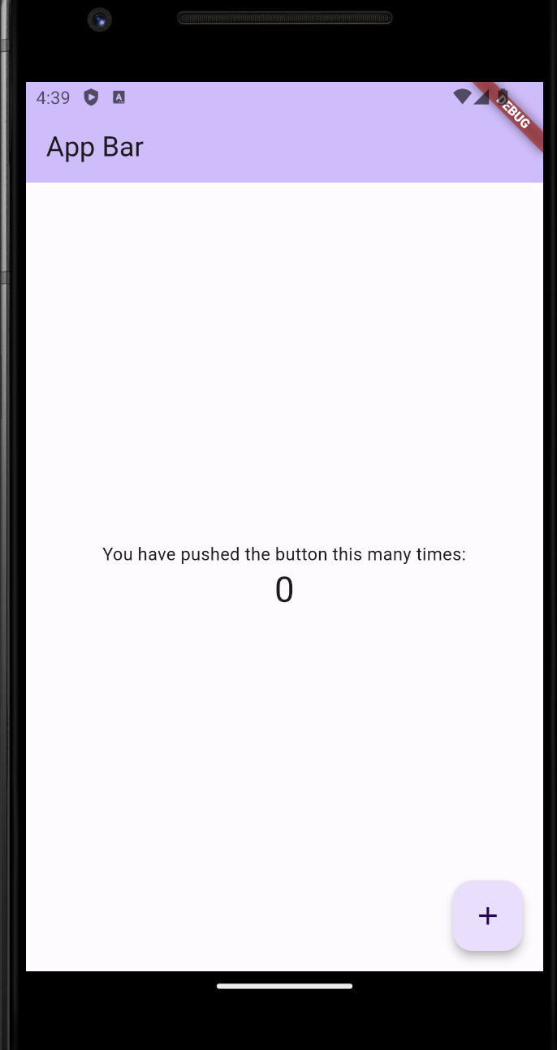
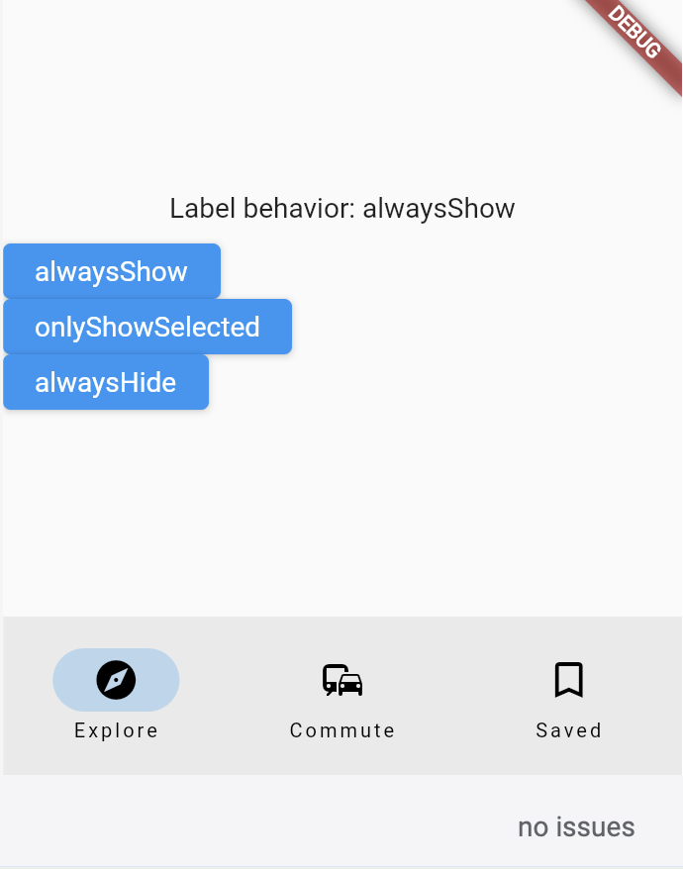
Scaffold （鷹架）
App bar
App bar
Body
Bottom navigation bar
Floating action button
Body
Floating action button
Bottom navigation bar
Notes:
https://docs.flutter.dev/ui/widgets/material

Slide 32
Dart variable type 變數型態
Data type | Keyword | Description
Number | Int, double | 數值型態，又分成整數及浮點數
Strings | String | 字串
Booleans | bool | 分成True和false
Lists | List | 有序陣列物件
Maps | Map | Key-Value pairs

Slide 33
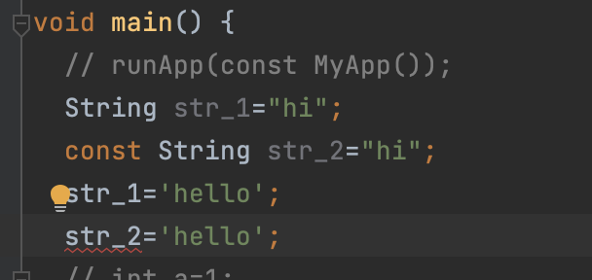
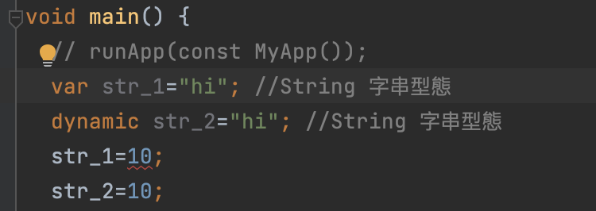
Variable declaration(變數宣告)
const: constant
final: constant
var: normal variable
dynamic: same as var, but can change variable type

Slide 34
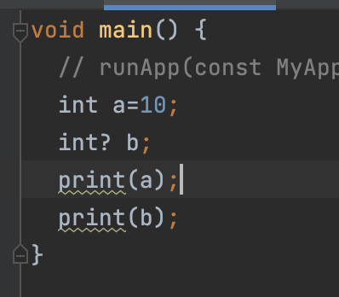
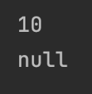
Variable declaration
Declare b as nullable

Slide 35
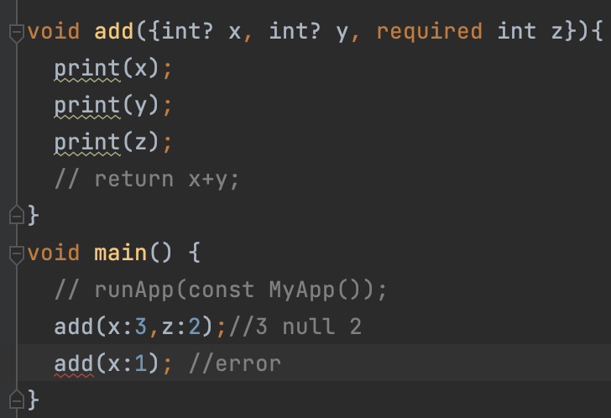
Name function parameters
Pass parameter by name.
Named parameter are default optional
You can add required keyword
Assign default value with “ : ”

Slide 36
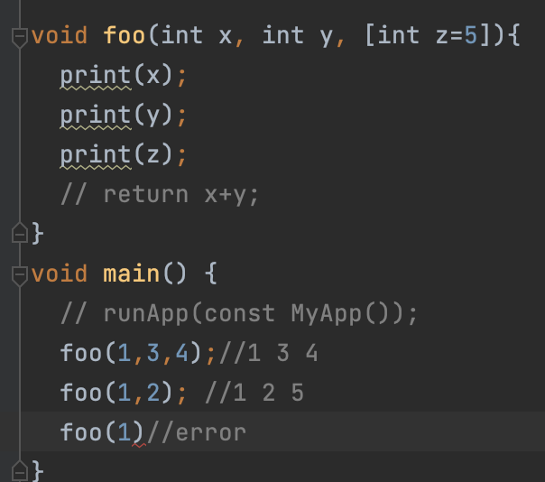
Positional function parameters
Pass parameter by position (i.e. position matters.)
Positional parameter are default required
You can add [ ] to make it optional
Assign default value with “:”

Slide 37
Android studio tip 1
Code formating
Windows: ctrl + alt + L
IOS: options + command + L

Slide 38
Android studio tip 2
Windows: alt + enter
IOS: options + enter
功能
Wrap with widget
Remove widget
更改widget的狀態
StatelessWidget => StatefulWidget
StatefulWidget => StatelessWidget

Slide 39
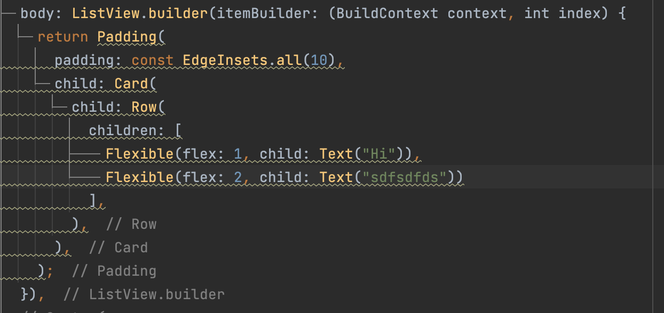
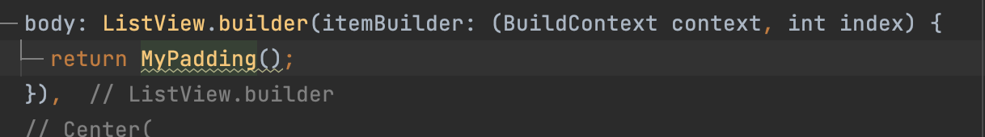
Android studio tip 3
Refactor
提取建立好的widget，形成一個新的class
好處：簡化程式碼，可重複使用！
Refactor後
Refactor前

Slide 40
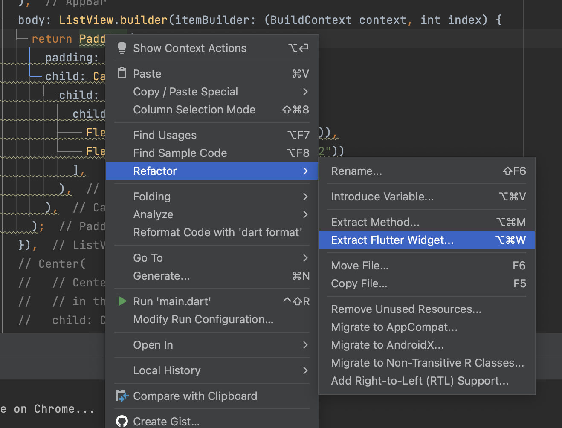
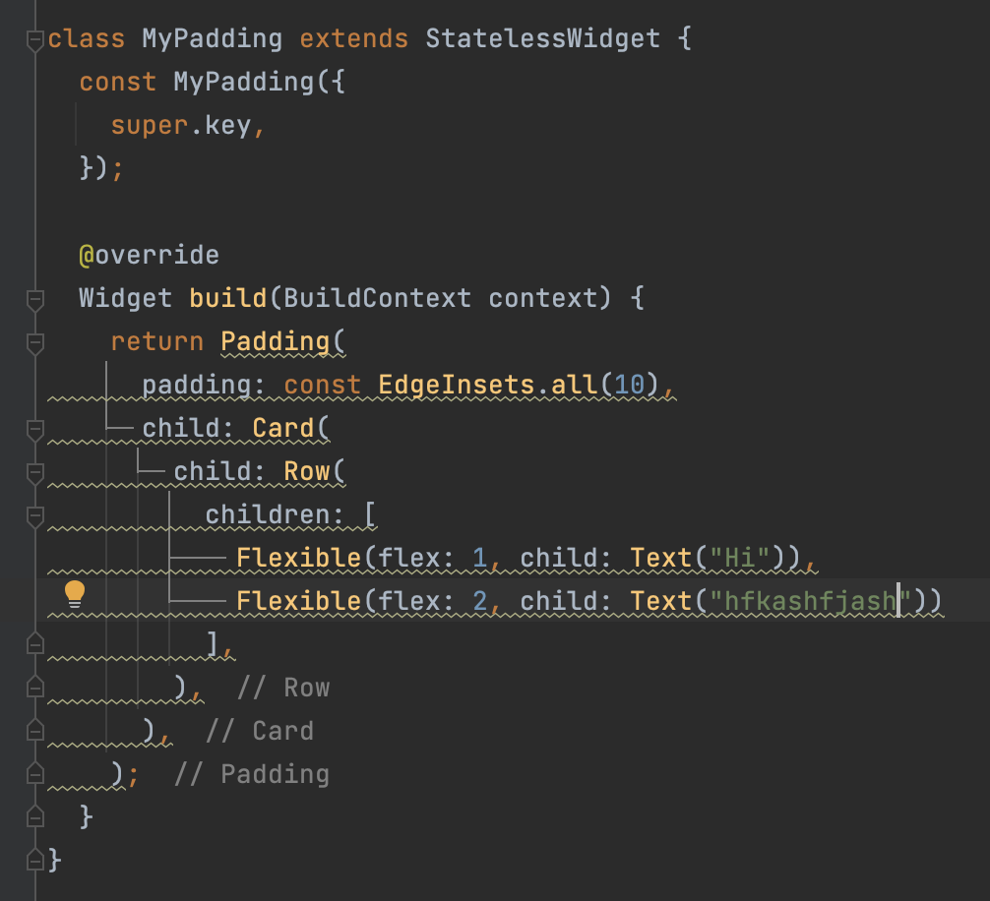
Android studio tip 3
Refactor
右鍵 >Refactor > Extract Flutter Widget

Slide 41
介面設計構想

Slide 42
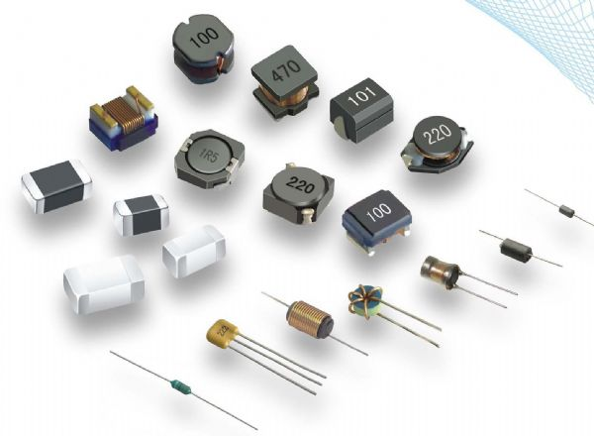
Everything is a widget

Slide 43
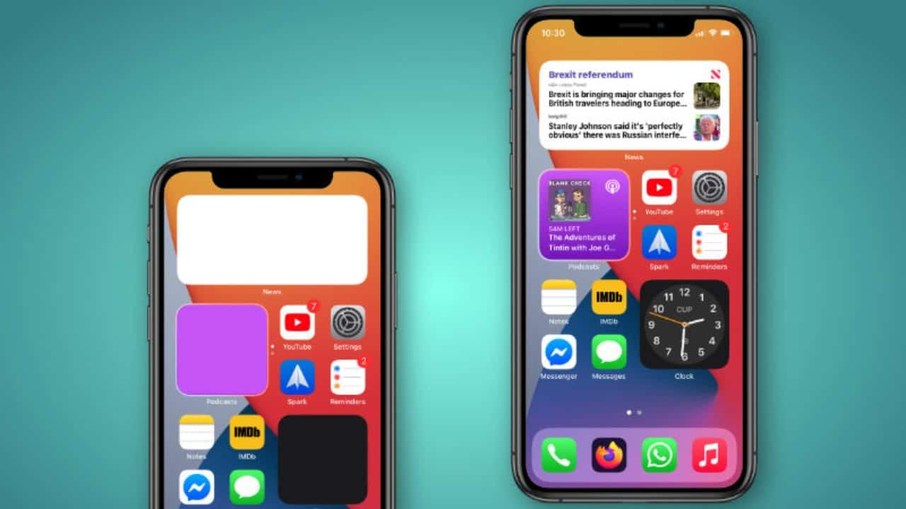
Everything is a widget

Slide 44
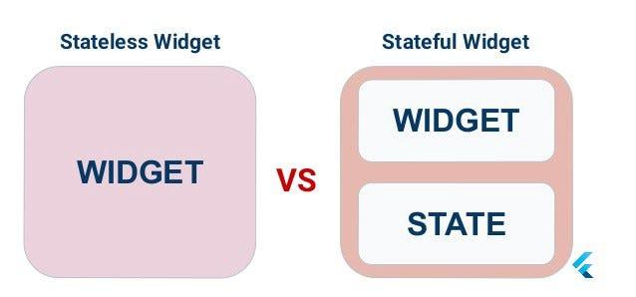
Class extends StatelessWidget/StatefulWidget

Slide 45
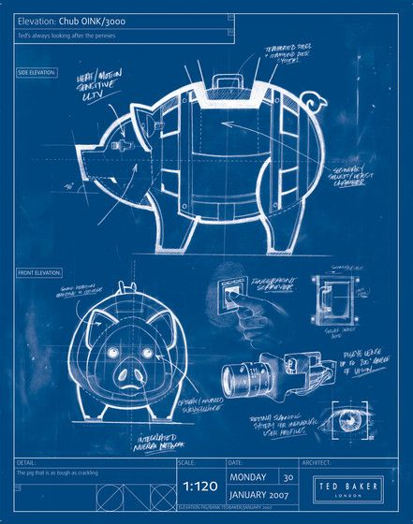
StatelessWidget
Stateless widgets are blueprint
Immutable
Any change in data, widgets, icons, or variables do not change the state of the app or UI
Simply override the build() method and return a widget

Slide 46
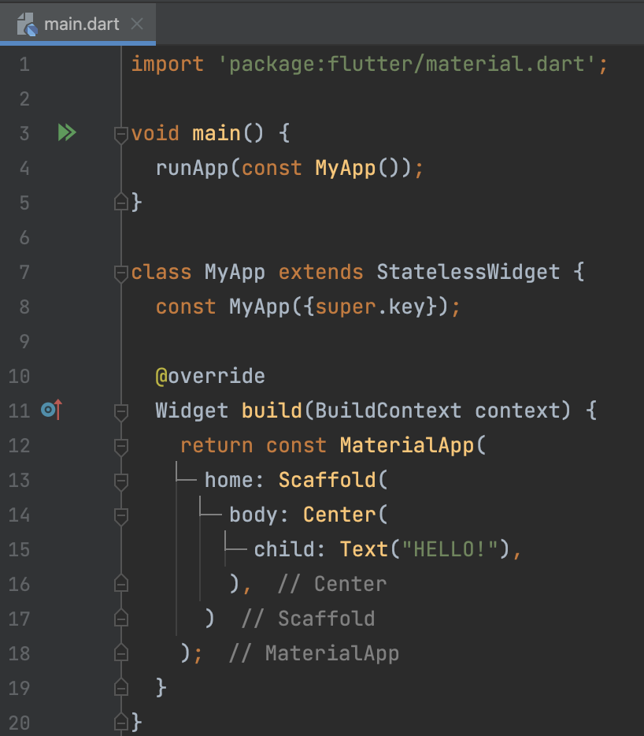
Build StatelessWidget
Describe to build the widget
以功能區分 widget
實質物件的 widget
名詞
例如：Text, Image, Icon, Button
描述行為的 widget
形容詞
例如：Center, GestureDetector

Slide 47

Build StatelessWidget
Describe to build the widget
以功能區分 widget
實質物件的 widget
名詞
例如：Text, Image, Icon, Button
描述行為的 widget
形容詞
例如：Center, GestureDetector

Slide 48

Composition
Wrapping widgets with widget
Top to down composition
The child widgets are dependent on their parent
child : 包一個 widget
children : 包很多個 widget
例如：Center 的規範是 child，只能放一個 widget 在中間
例如：Column （垂直佈局）的規範是 children，可以以垂直方式放多個widget

Slide 49


Composition
Wrapping widgets with widget
Top to down composition
The child widgets are dependent on their parent
child : 包一個 widget
children : 包很多個 widget
例如：Center 的規範是 child，只能放一個 widget 在中間
例如：Column （垂直佈局）的規範是 children，可以以垂直方式放多個widget

Slide 50


Composition
Wrapping widgets with widget
Top to down composition

Slide 51


Essential widgets used
Text：文字物件
Icon：圖示物件
Image：圖片物件
Expanded：擴展其子物件以填滿可用空間 -> 防止overflow
Container：容器佈局（只放一個物件）
ListView : 可捲動的 list
Column：垂直佈局（排列多個物件）
Row：水平佈局（排列多個物件）

Slide 52
StatefulWidget
Stateful widget
Dynamic
Stateful widget overrides the createState() and returns a state
Stateful widgets are those widgets whose state can be changed in real-time
常見的 Stateful widget 有：
Radio
Form
Checkbox

Slide 53

StatefulWidget
When we first create a stateful widget, its state is created as well.

Slide 54
StatefulWidget
We specify the build method in the state class

Slide 55

StatefulWidget
We can chage a stateful widget's state by calling setState()

Slide 56
StatefulWidget
When state change, Flutter mark the widget as dirty and rebuild the widget
But the state will survive the widget rebuild

Slide 57

Common Pattern
Parent control the state
Child1 : handle display (pass data)
Child2 : handle user input (pass callback function)

Slide 58
Common Pattern
User event → callback triggered (use setState() ）→ state changed → rebuild child1 and child2 → display result

Slide 59
Asynchronous Programming

Slide 60

Asynchronous Programming
Let your program complete work while waiting for another slow computation to finish.
Fetching data over a network.
Writing to a database.
Reading data from file.
Such computation usually proivde Future or Stream as the result.
source: https://dart.dev/guides/language/concurrency

Slide 61


Asynchronous Programming
Future is a gift box. The result of the Future is either
success
failure
You have to wait for the future to finish in order to get the things inside.
source: https://www.istockphoto.com/illustrations/gifts
source: https://www.vectorstock.com/royalty-free-vector/clock-icon-timer-watch-vector-26936779

Slide 62


Asynchronous Programming
async, await let you write asynchronous code like synchronous code.
Synchronous Code
Asynchronous Code

Slide 63


Asynchronous Programming
FutureBuilder : Check future status to display different UI.
利用 snapshot 當條件式來確定 future 執行的狀態
完成
失敗
處理中...

Slide 64

作業
完成 Building layouts 的教學 截圖繳交 <姓名>.png

